Slide 1


Kinamatics of Machinary(KOM) presentation on
Robotic Arm Mechanism using Servo Motor
Presented by
Mr . KakadAbhishek Satu | 23 | S190101526
Mr . Kale Abhishek Subhash | 24 | S190101527
Mr . Karle Rushikesh Shivshankar | 25 | S190101528
Mr . Kawade Ganesh Popat | 27 | S190101530
Mr . Mule Ashutosh Bhausaheb | 37 | S190101541
Under the Guidance of
Prof. Pathade sir

Slide 2
Contents
Introduction
Project Motivation
Problem Statement
Aims & Objectives
Literature Survey
Components
Interfacing Diagram
Mechanism Specifications
Advantages & Limitations
Future Scope
Conclusion
Photos & Videos

Slide 3
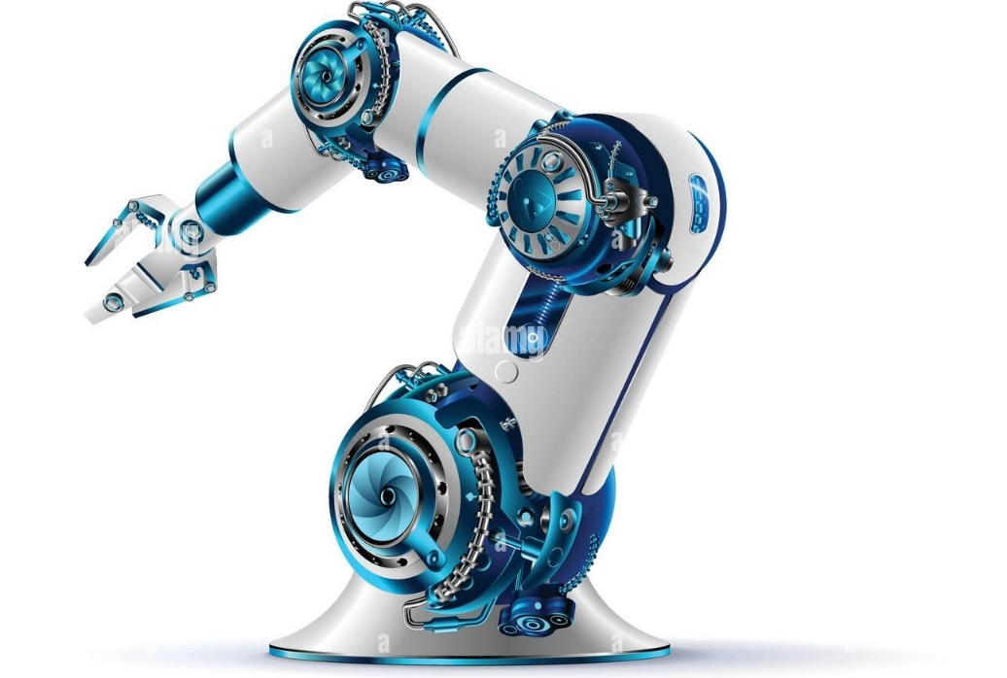
Introduction:
Robots will play an important role in providing physical assistance and even companionship for the elderly."
-Bill Gates
Robotic arm is mechanical arm like structured robot that is capable of lifting objects and keeping it in desired plane within the limit of arms.
A Robotic Arm is a manipulator with programmable memory having similar functions as human hand

Slide 4
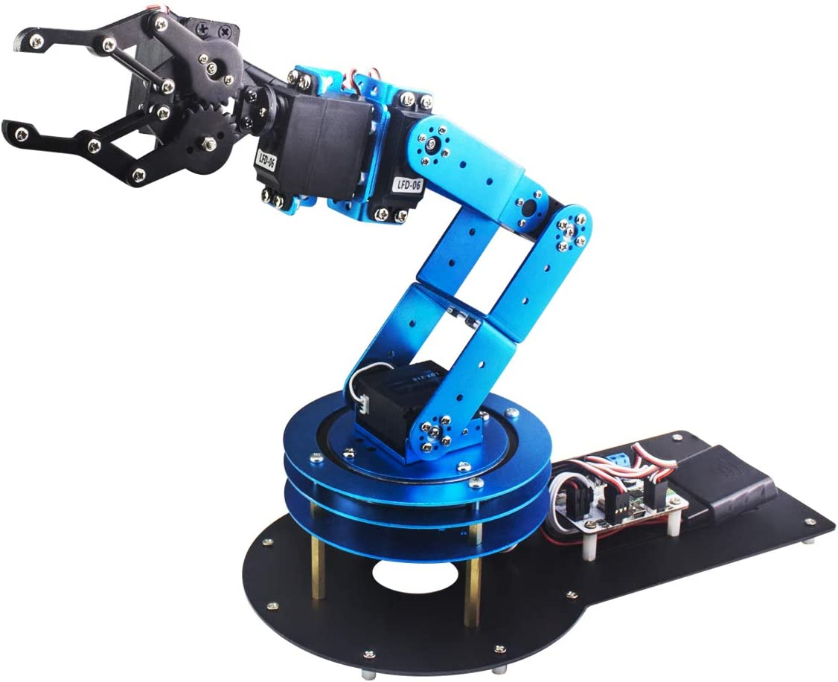
MOTIVATION:
As manual labour is being reduced at big scale industries and factories to increase efficiency and gain profit by installing robots that can respective works.
A simple robotic arm is one of the most commonly installed machines. We are introducing the basic concepts of an Arduino controlled robotic arm projects.
Robots are used in science and industry or entertain humans and although they do nots exactly looks like humans performing the tasks. In fact,some of the most popular in industry are robot manupulators which reassembles.

Slide 5
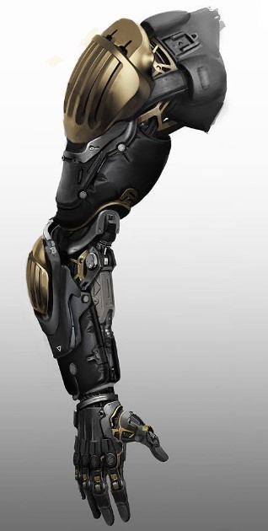
AIM & Objectives:
Robotic arms are fast, accurate and reliable, and can collectively be programmed to perform an almost infinite range of different operations.
Robotic arms can be used for all manner Of industrial production, processing and manufacturing roles - any task in which extremely precise. fast and repeatable movements are required.
At times humans may tend to error or get tired or may not be competent to work at certain levels and hence the use of Robotic Arm becomes Mandatory Robot arms are ideal for operations which are repetitive, consistent and require a very high degree of accuracy.

Slide 6
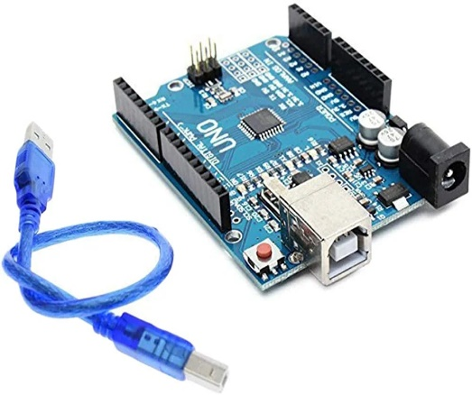
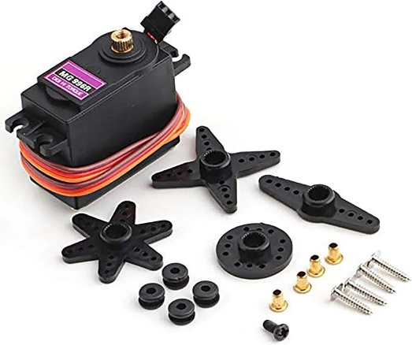
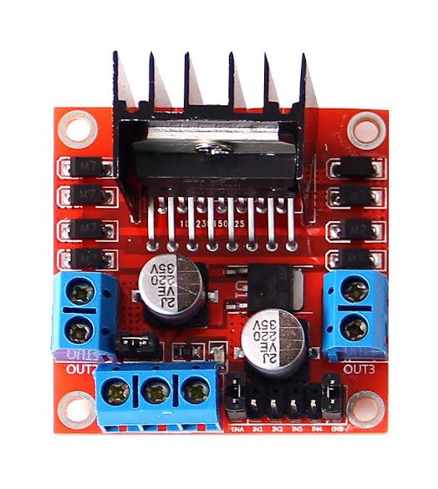
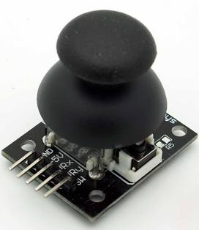
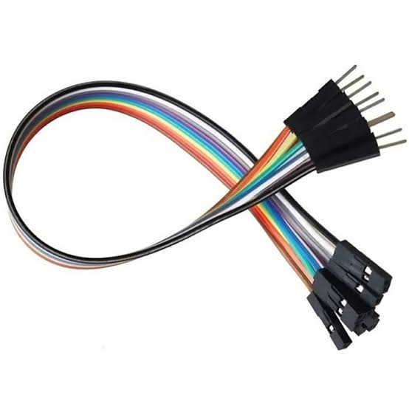
ComponentS:
Components used in this project is as follows:
Ardino UNO
Servo Motors
Motor Drivers
Joystick Module
Jumping Wires

Slide 7
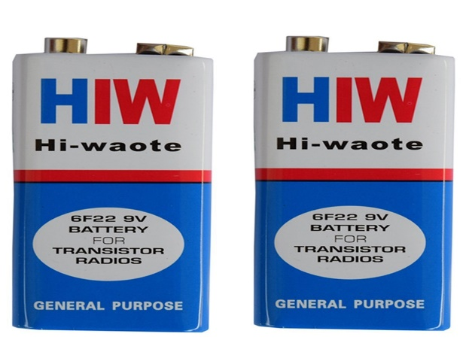
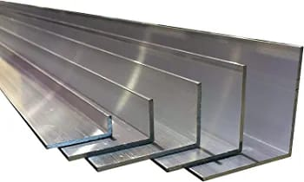
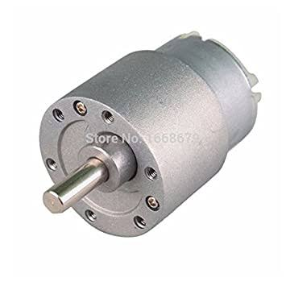
COMPONENTS:
9v Battery
Aluminium Metal
DC Motor

Slide 8
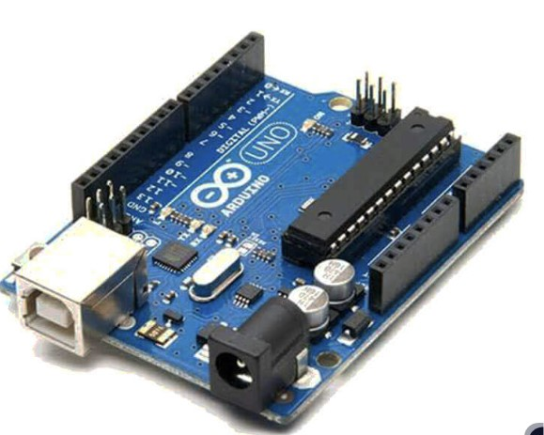
SPECIFICATIONS:
Microcontroller | ATmega328P – 8 bit AVR family microcontroller
Operating Voltage | 5V
Recommended Input Voltage | 7-12V
Input Voltage Limits | 6-20V
Analog Input Pins | 6 (A0 – A5)
Digital I/O Pins | 14 (Out of which 6 provide PWM output)
DC Current on I/O Pins | 40 mA
DC Current on 3.3V Pin | 50 mA
Flash Memory | 32 KB (0.5 KB is used for Bootloader)
SRAM | 2 KB
EEPROM | 1 KB
Frequency (Clock Speed) | 16 MHz
Ardino UNO

Slide 9
SPECIFICATIONS:
Operating Voltage: | +5V typically
Current: | 2.5A (6V)
Stall Torque: | 9.4 kg/cm (at 4.8V)
Maximum Stall Torque: | I I kg/cm (6V)
Operating speed: | 0.17
Gear Type:
Rotation : | 360
Weight Of Motor: | 55gm
MG996 Servo motor

Slide 10
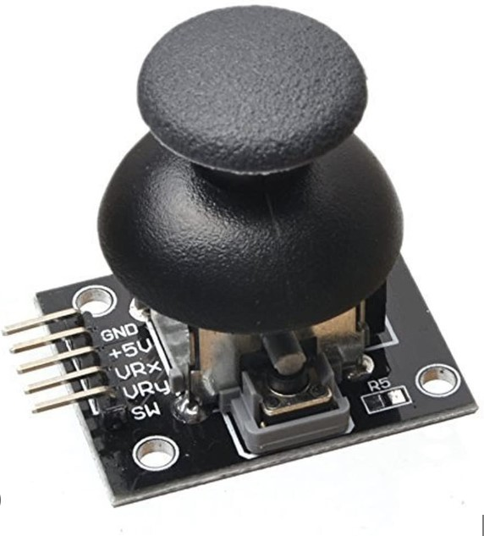
SPECIFICATIONS:
Operating Voltage | 5V
Internal Potentiometer value | 10K
Operating temperature | 0 to 70 °C
Potentiometer Outputs | Analog outputs range of 0 to 1023 (0v – 5v)
Pushbutton Output | Digital output Active Low
Dimensions | 40 x 27 x 15 (LxWxH) mm
Weight | 10gm (without Hat)
Joystick Module

Slide 11
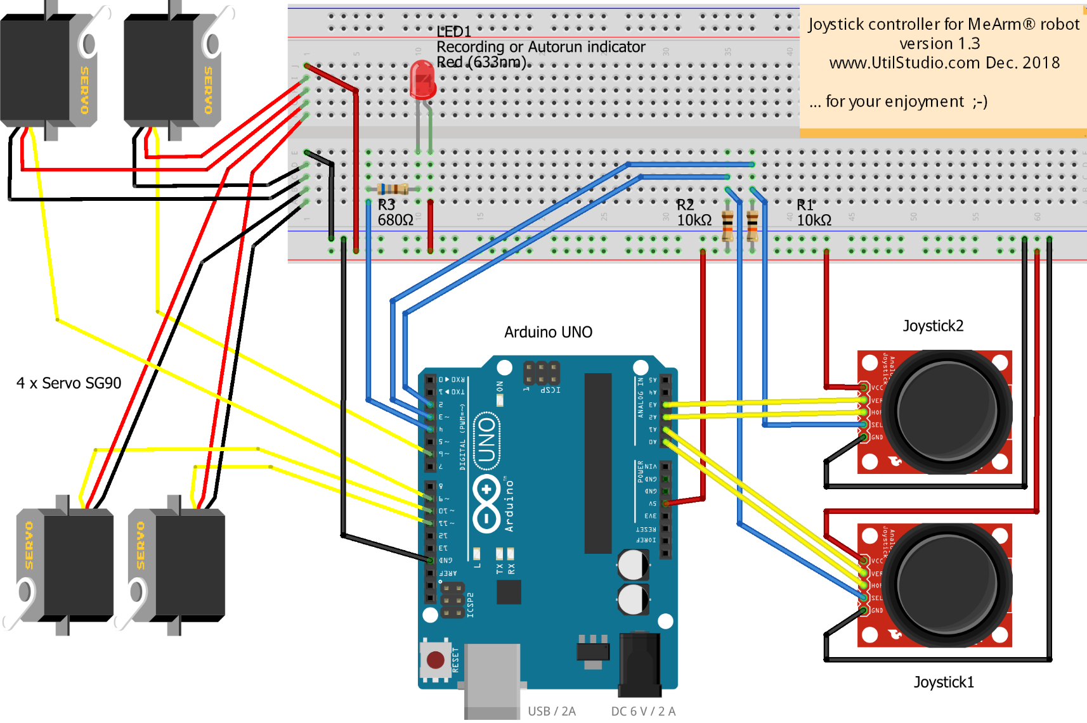
INTERFACING DIAGRAm:

Slide 12
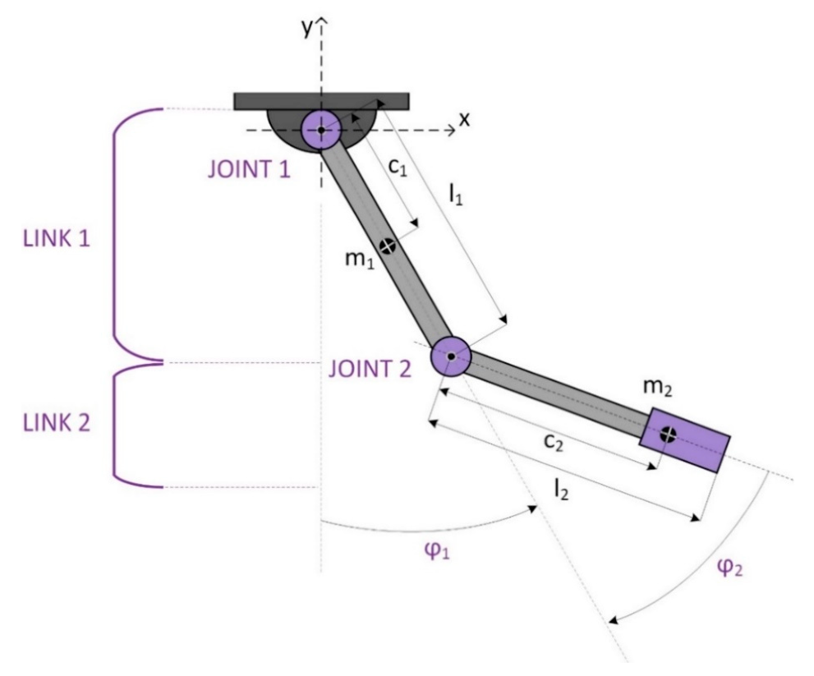
Mechanism Specifications:
Totally 4 motos are used in this robotic arm mechanism
3 Servo motors and 1 high power dc motor
Dc motor is being attached at sholder to get 360* moverments
3 Servo motors are attached at elbow,wrist and for gripper movements.
All movements are being done by joystick control.

Slide 13
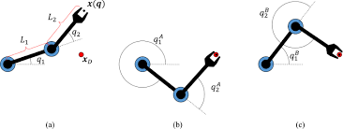
Mechanism Specifications:
It having 5 Degree of Freedom
These are as follows:
Forward & Backward movement of Sholder.
Upward & Downward Movement Of Elbow
Ratational Movement of the wrist.
These Movements can be done by this Robotic Arm Mechanism

Slide 14
Advantages:
Cost Effectiveness:
There will be no lunchbreaks, holidays, sick leave or shift time allocated for robotic Improved.
Quality Assurance:
Robotic automation eliminates the risks of vigilance decrement by accurately producing and chocking items meet the required standard without fail.
Increased Productivity:
Due to continuous and stress less work the production will take place continuously and will boost the production.
Work In Hazardous Environments:
If a high level of chemicals are present, robotic automation offers the ideal solution, as it will continue to work without harm, even in areas that have extremely high or low temperatures Robotics will prove themselves the best

Slide 15
Disadvantages:
Potential Job Losses:
One of the biggest concerns surrounding the introduction of robotic automation is the impact of jobs for workers. If a robot can perform at a faster, more consistent rate, then the fear is that humans may not be needed at all.
Initial Investment Costs:
This is typically the biggest obstacle that will decide whether or not a company will invest in robotic automation, or wait until a later stage. The cash flow must be sustainable in the meantime and the stability of the company is by no means worth the risk if the returns are only marginal.
Hiring Skilled Staff:
Over the past decade manufacturers have found it harder to source skilled staff members to fill the specialized roles in their factories.

Slide 16
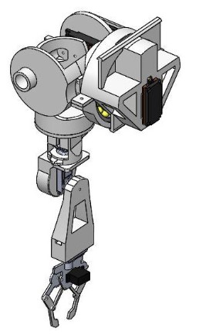
Future scope
If more time and more efforts would have been put into the model, more complexity could have been brought out.
Moreover instead of manual operation of switches and controller could have been replaced by pre-defined computer program or merely by pressing switch operated.
Further more varieties and more flexibility to add or replace any part according to the requirements can be done to improve its use and increase field of usage and to make it more universal or flexible.

Slide 17
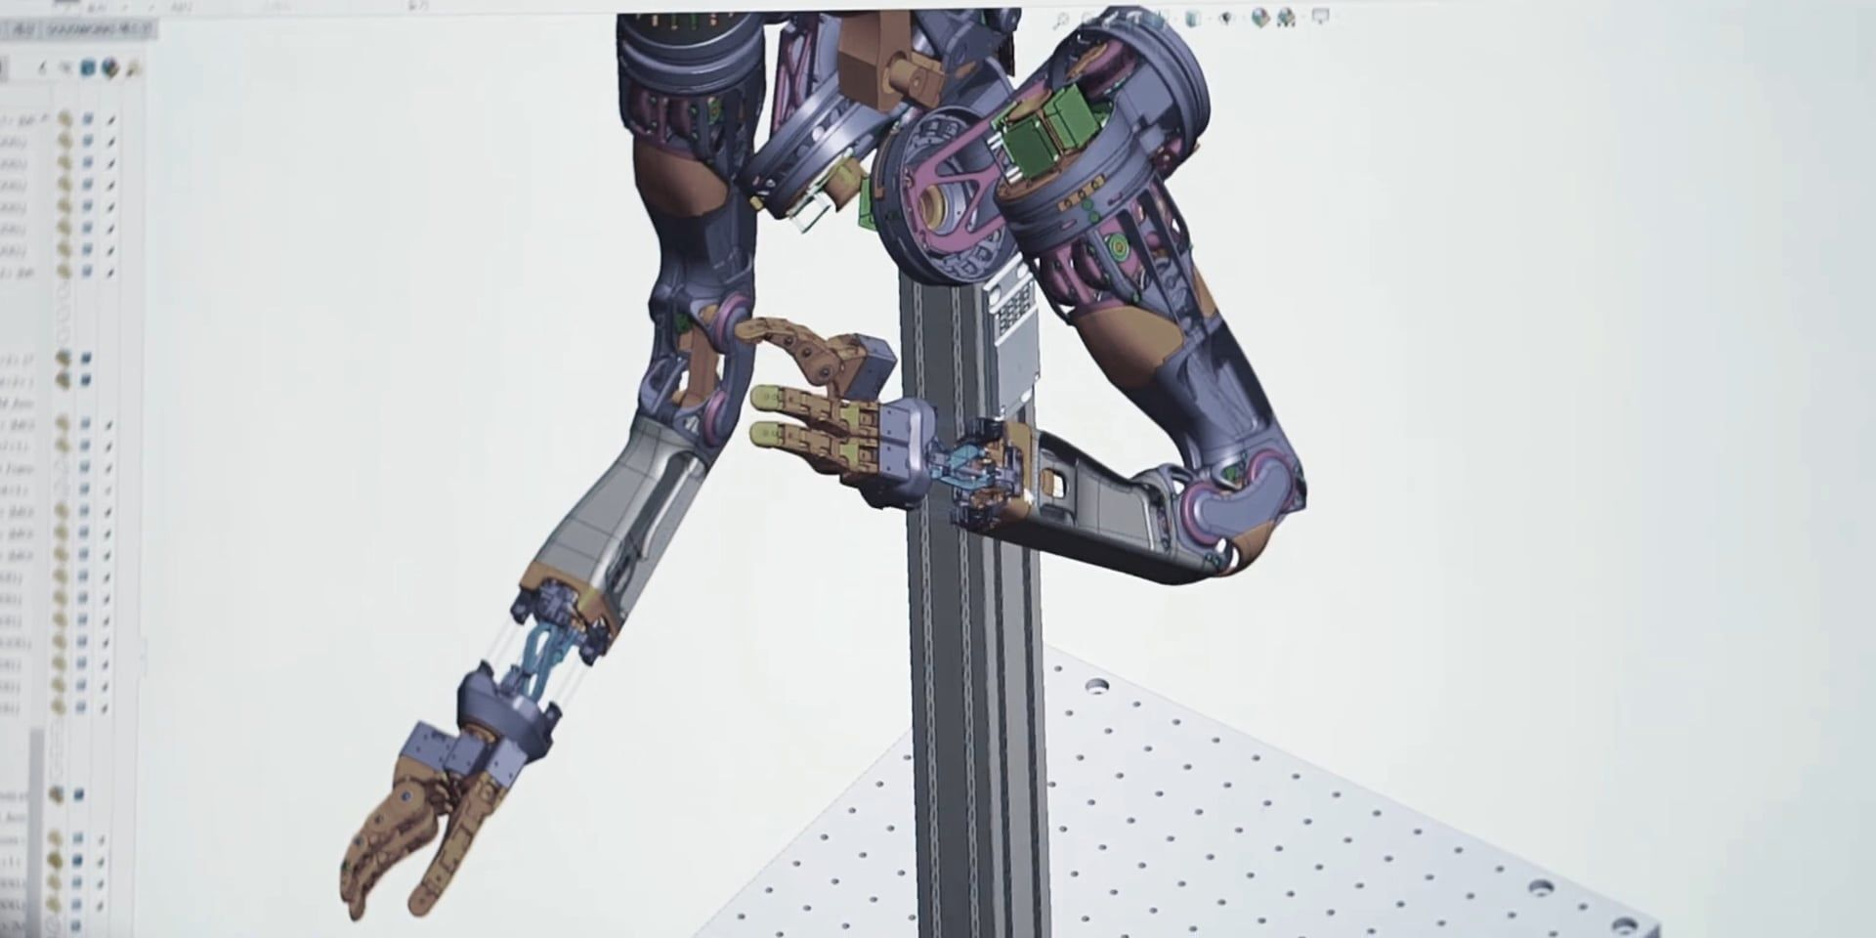
Conclusion:
Thus we had prepared mechanism has been successfully constrained and executed to carry out the required work of picking up the weight of the object like table tennis ball and to put them in to the placed at different location.
This robot can be modified using some of the latest techniques to make it more flexible and addition of movable joints to increase its working capacity.

Slide 18
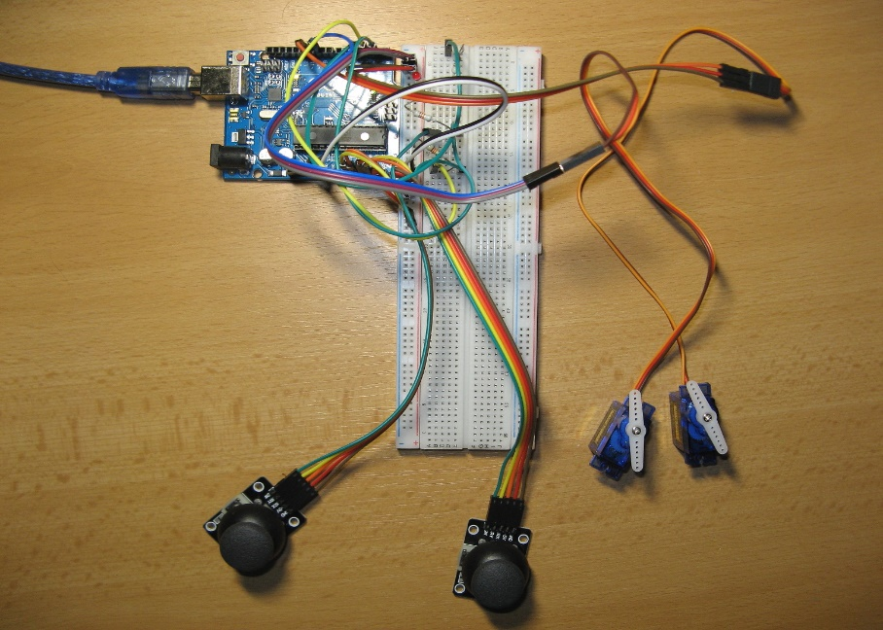
Photos & videos

